Slide 1
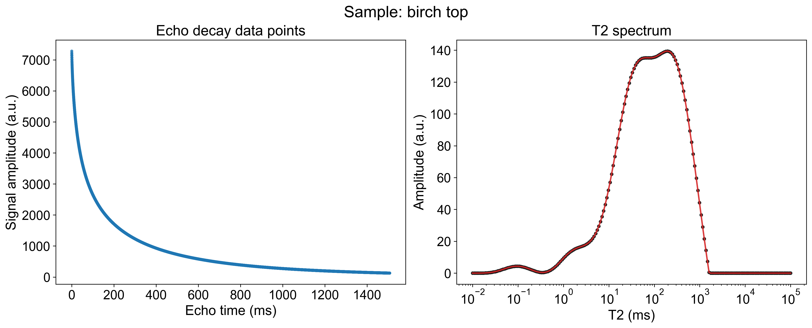
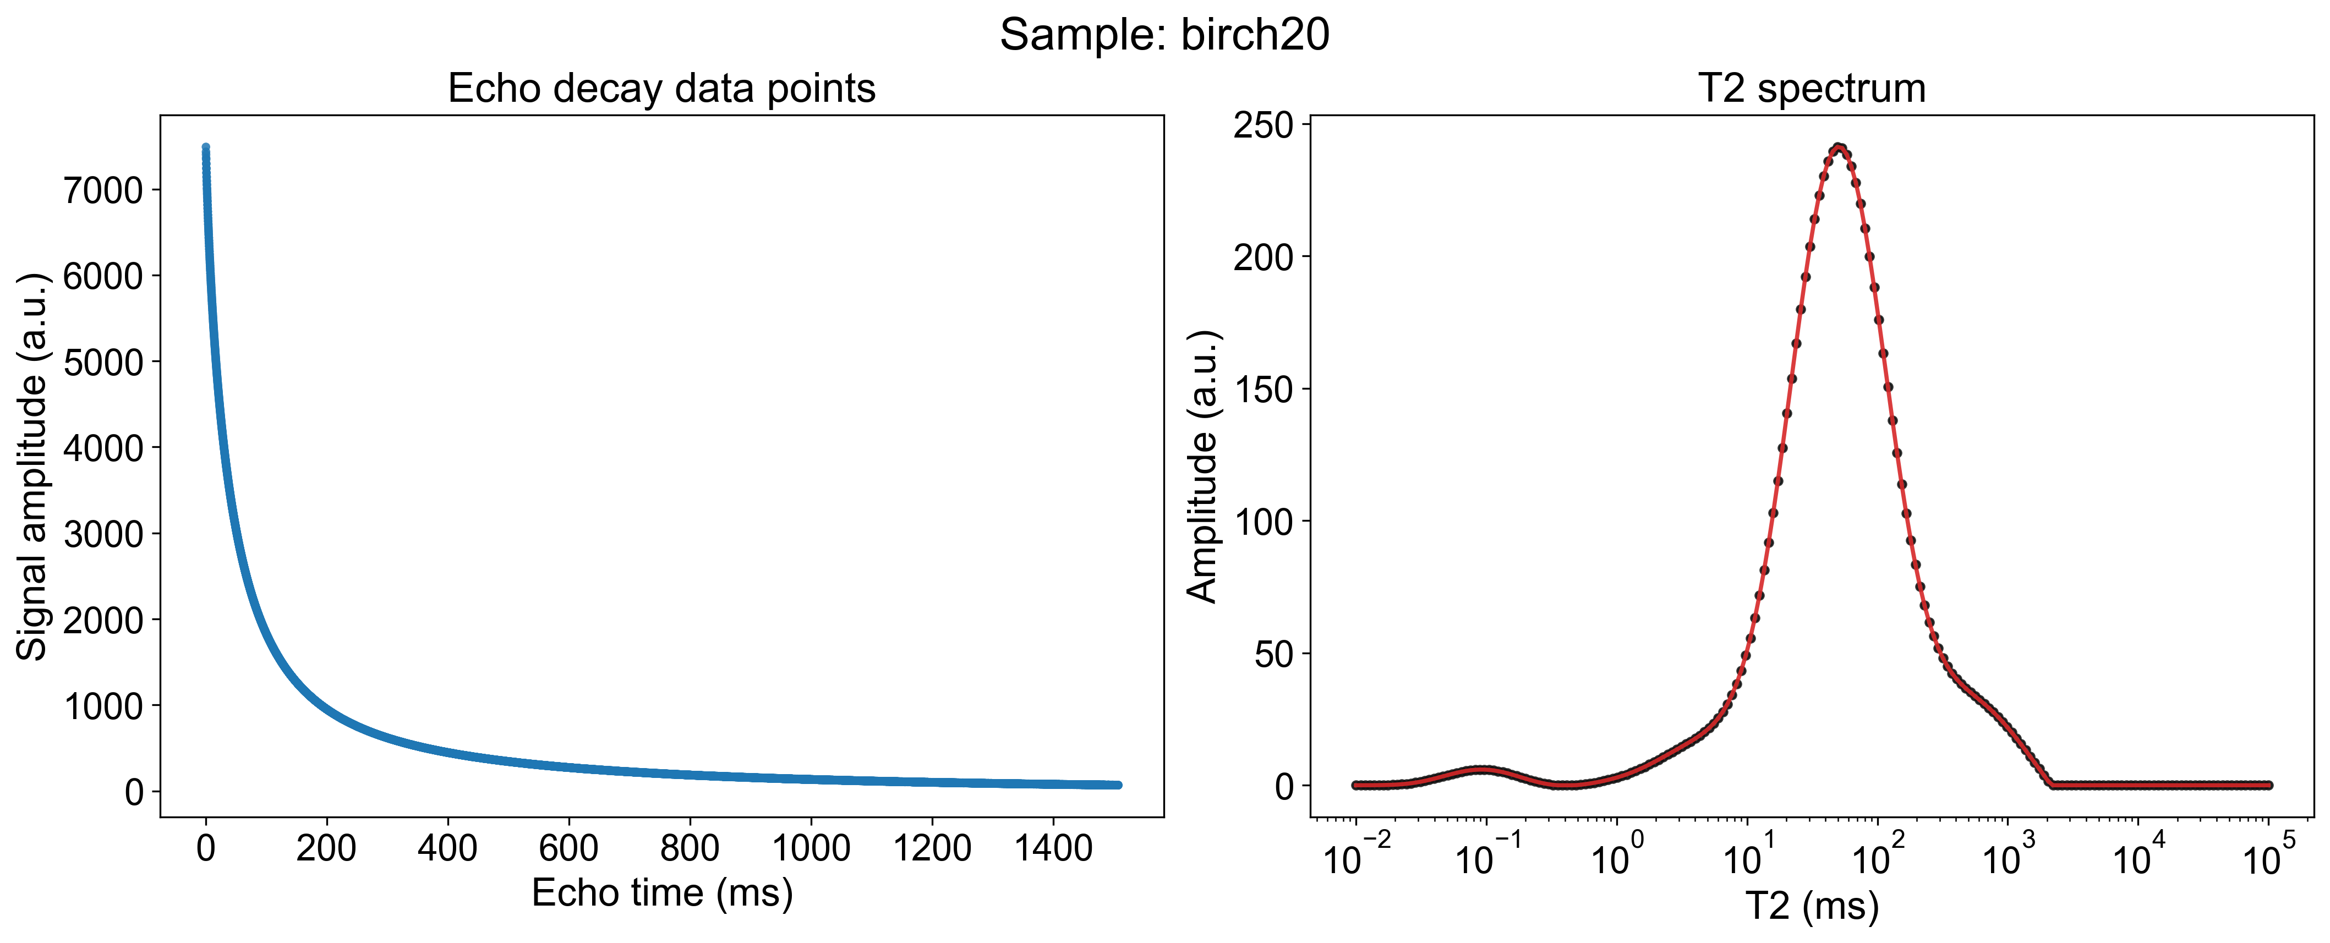

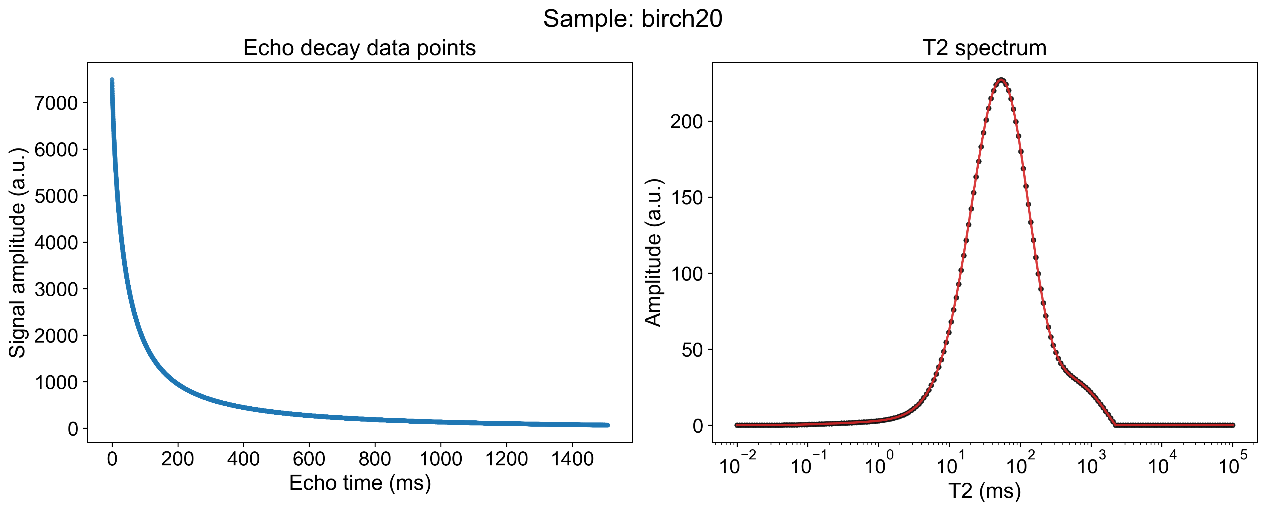
Nidhal's experimental data was inverted using the BRD algorithm via the laboratory software
Nidhal's experimental data was inverted using the NNLS algorithm via the Bin’s code
NUM_BINS = 200
REG_PARAM = 0.1
T2_MIN_MS = 1e-2
T2_MAX_MS = 1e5
NUM_BINS = 200
REG_PARAM = 0.01
T2_MIN_MS = 1e-2
T2_MAX_MS = 1e5
BRD algorithm via the
laboratory software

Slide 2
Nidhal's experimental data was inverted using the BRD algorithm via the laboratory software
Nidhal's experimental data was inverted using the NNLS algorithm via the Bin’s code
NUM_BINS = 200
REG_PARAM = 0.1
T2_MIN_MS = 1e-2
T2_MAX_MS = 1e5
NUM_BINS = 200
REG_PARAM = 0.01
T2_MIN_MS = 1e-2
T2_MAX_MS = 1e5
BRD algorithm via the
laboratory software

Slide 3
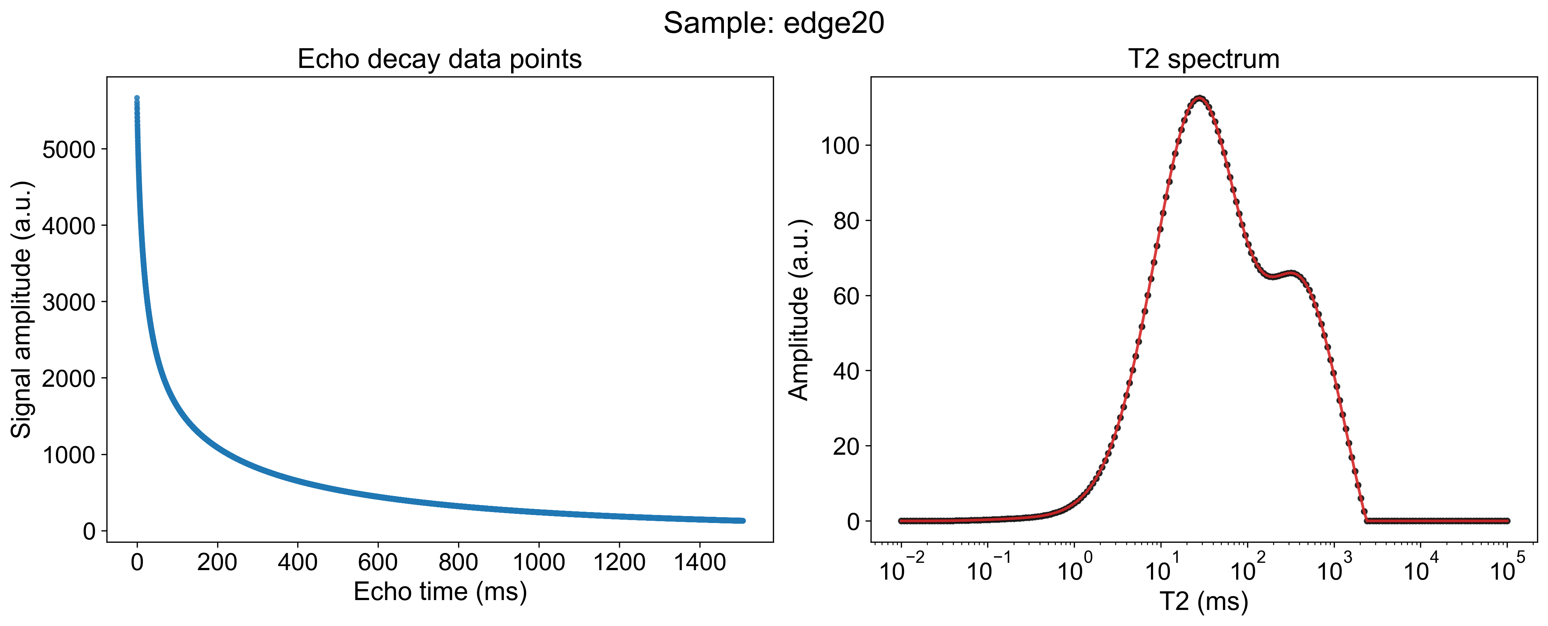
Nidhal's experimental data was inverted using the BRD algorithm via the laboratory software
Nidhal's experimental data was inverted using the NNLS algorithm via the Bin’s code
NUM_BINS = 200
REG_PARAM = 0.1
T2_MIN_MS = 1e-2
T2_MAX_MS = 1e5
NUM_BINS = 200
REG_PARAM = 1
T2_MIN_MS = 1e-2
T2_MAX_MS = 1e5
BRD algorithm via the
laboratory software

Slide 4
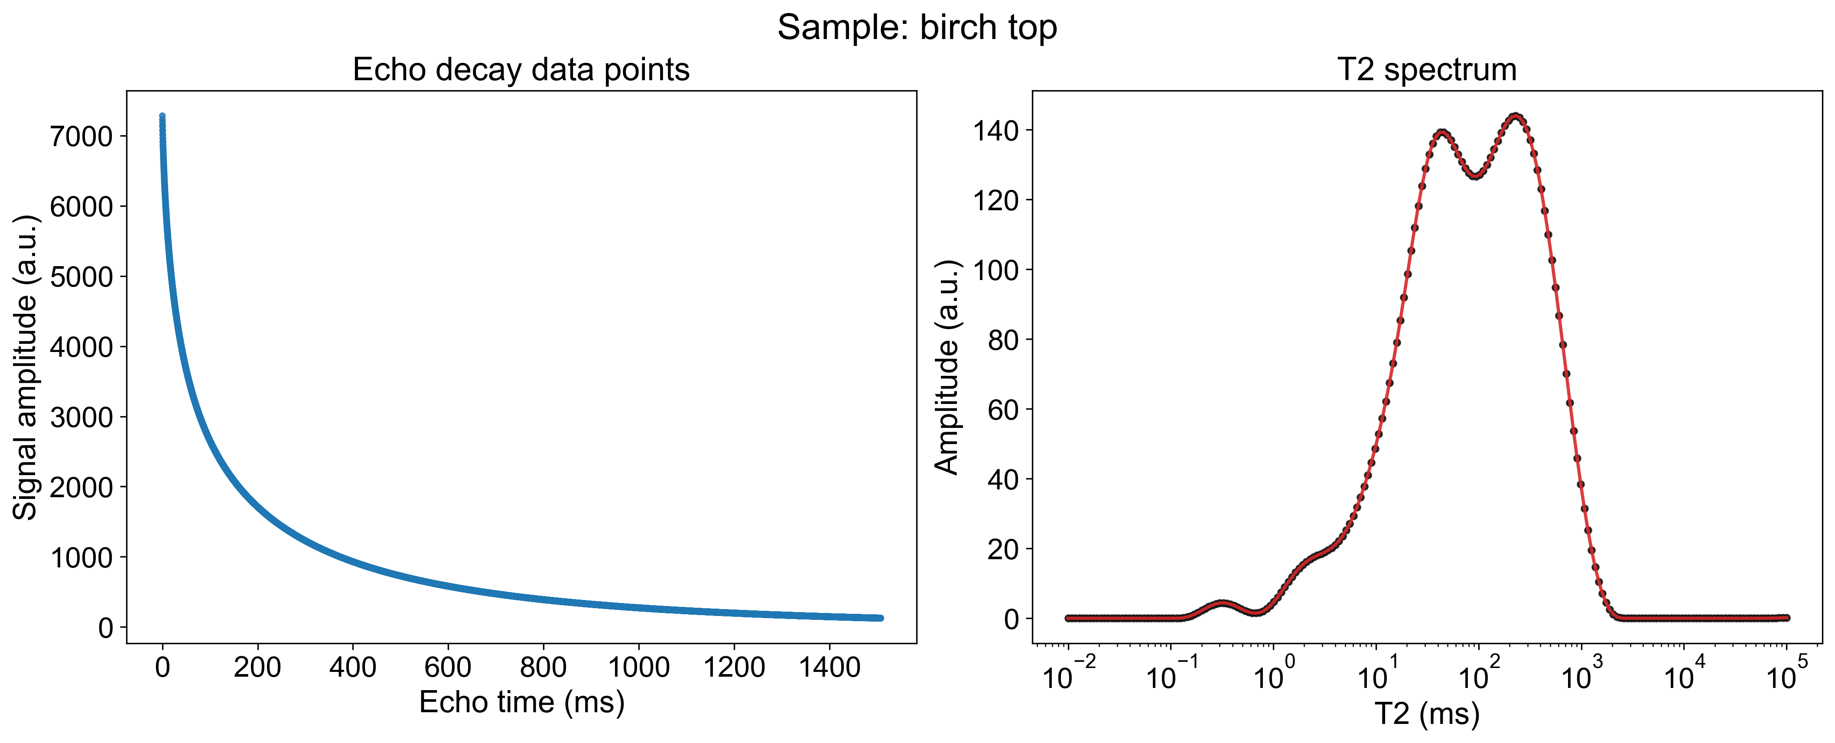
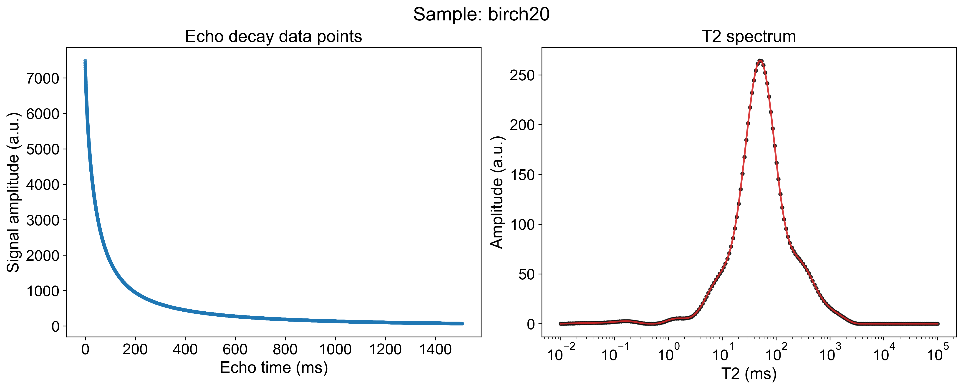
Nidhal's experimental data was inverted using the BRD algorithm via the laboratory software
Nidhal's experimental data was inverted using the NNLS algorithm via the Chi’s code
NUM_BINS = 200
REG_PARAM = 0.1
T2_MIN_MS = 1e-2
T2_MAX_MS = 1e5
NUM_BINS = 200
REG_PARAM = 1
T2_MIN_MS = 1e-2
T2_MAX_MS = 1e5
BRD algorithm via the
laboratory software

Slide 5
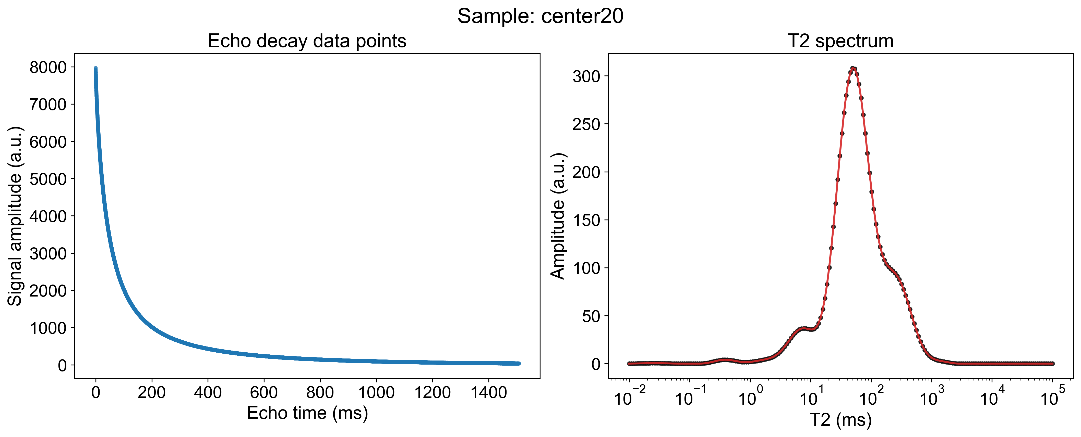
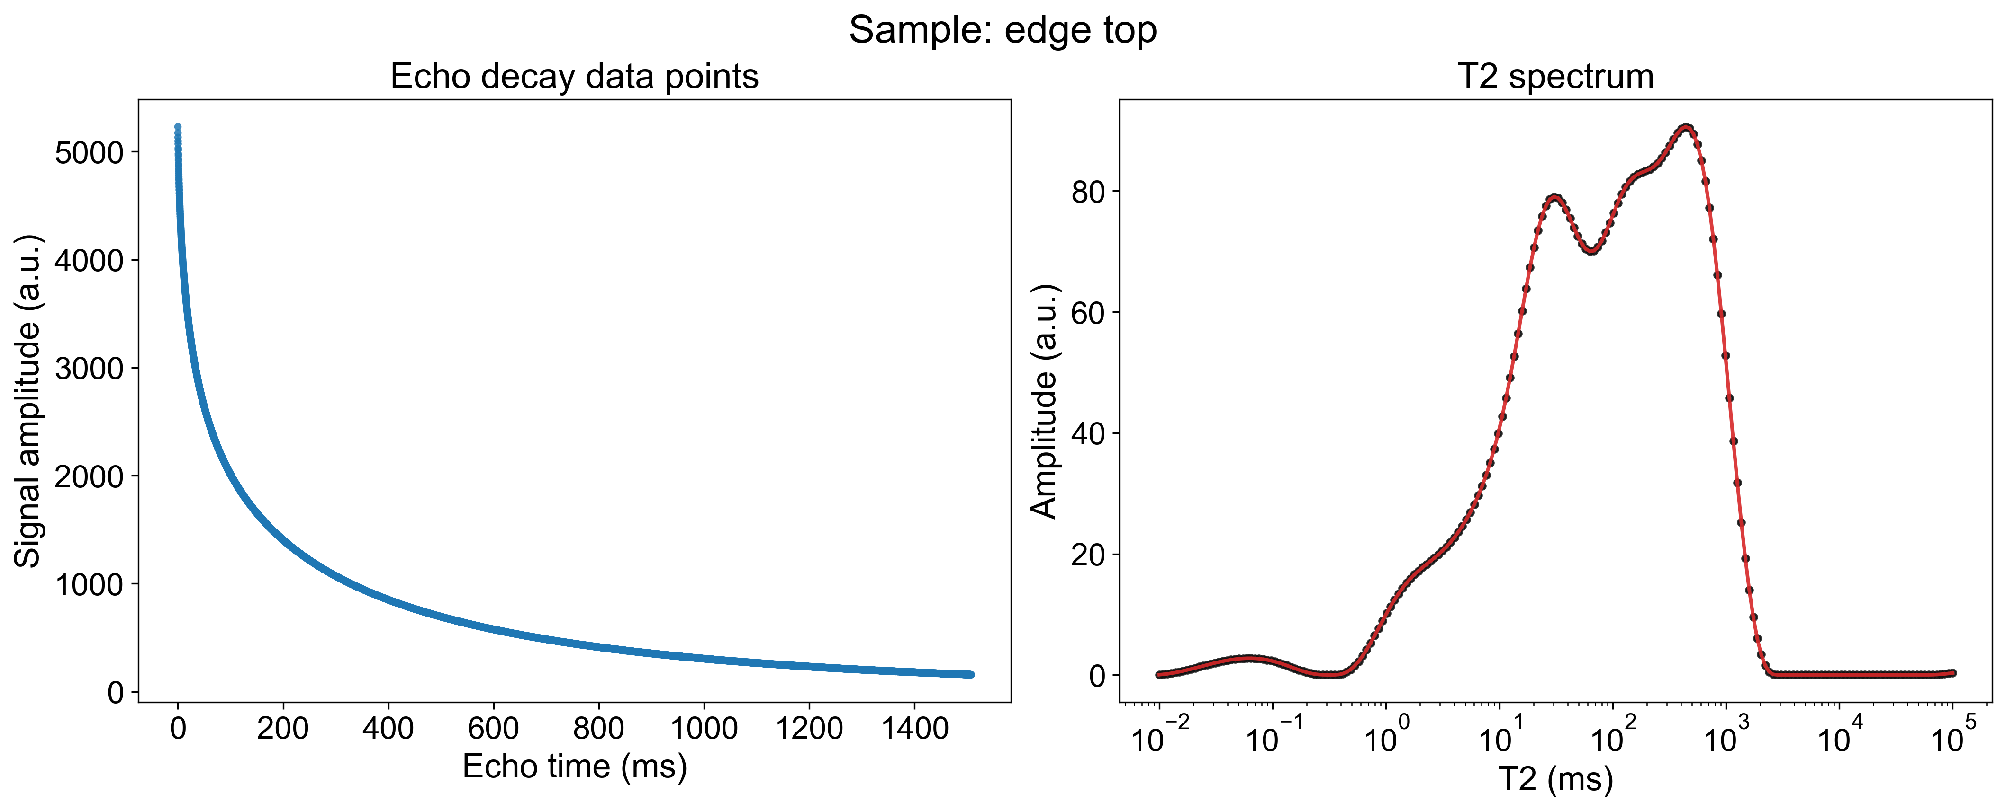
Nidhal's experimental data was inverted using the BRD algorithm via the laboratory software
Nidhal's experimental data was inverted using the NNLS algorithm via the Chi’s code
NUM_BINS = 200
REG_PARAM = 0.1
T2_MIN_MS = 1e-2
T2_MAX_MS = 1e5
NUM_BINS = 200
REG_PARAM = 1
T2_MIN_MS = 1e-2
T2_MAX_MS = 1e5
BRD algorithm via the
laboratory software

Slide 6
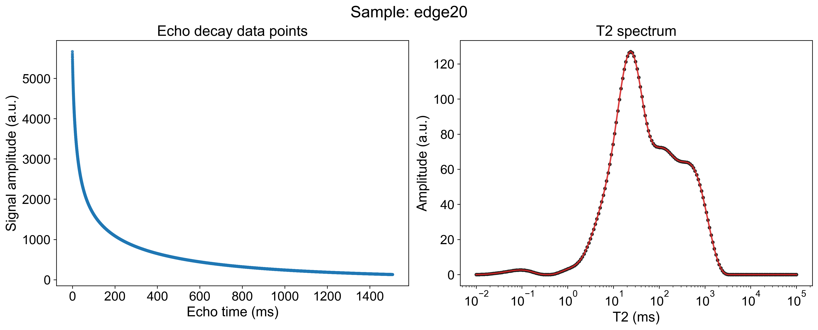
Nidhal's experimental data was inverted using the BRD algorithm via the laboratory software
Nidhal's experimental data was inverted using the NNLS algorithm via the Chi’s code
NUM_BINS = 200
REG_PARAM = 0.1
T2_MIN_MS = 1e-2
T2_MAX_MS = 1e5
NUM_BINS = 200
REG_PARAM = 1
T2_MIN_MS = 1e-2
T2_MAX_MS = 1e5
BRD algorithm via the
laboratory software

Slide 7


Nidhal's experimental data was inverted using the BRD algorithm via the laboratory software
Nidhal's experimental data was inverted using the BRD algorithm via the Junwen’s code
NUM_BINS = 200
REG_PARAM = 0.1
T2_MIN_MS = 1e-2
T2_MAX_MS = 1e5
NUM_BINS = 200
REG_PARAM = 0.1
T2_MIN_MS = 1e-2
T2_MAX_MS = 1e5
BRD algorithm via the
laboratory software

Slide 8

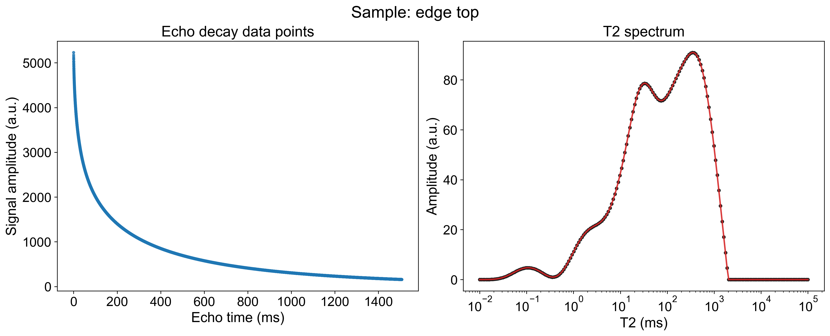
Nidhal's experimental data was inverted using the BRD algorithm via the laboratory software
Nidhal's experimental data was inverted using the BRD algorithm via the Junwen’s code
NUM_BINS = 200
REG_PARAM = 0.1
T2_MIN_MS = 1e-2
T2_MAX_MS = 1e5
NUM_BINS = 200
REG_PARAM = 0.1
T2_MIN_MS = 1e-2
T2_MAX_MS = 1e5
BRD algorithm via the
laboratory software

Slide 9

Nidhal's experimental data was inverted using the BRD algorithm via the laboratory software
Nidhal's experimental data was inverted using the BRD algorithm via the Junwen’s code
NUM_BINS = 200
REG_PARAM = 0.1
T2_MIN_MS = 1e-2
T2_MAX_MS = 1e5
NUM_BINS = 200
REG_PARAM = 0.1
T2_MIN_MS = 1e-2
T2_MAX_MS = 1e5
BRD algorithm via the
laboratory software

Slide 10


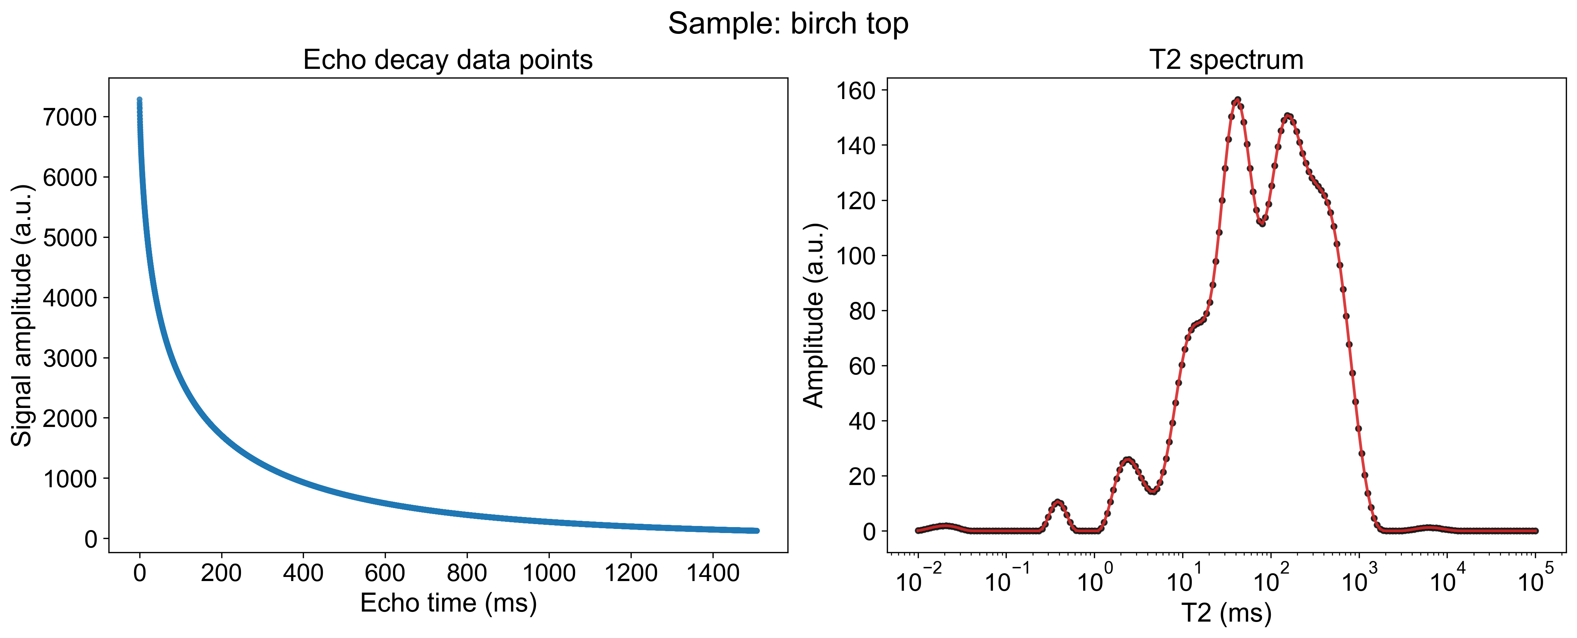
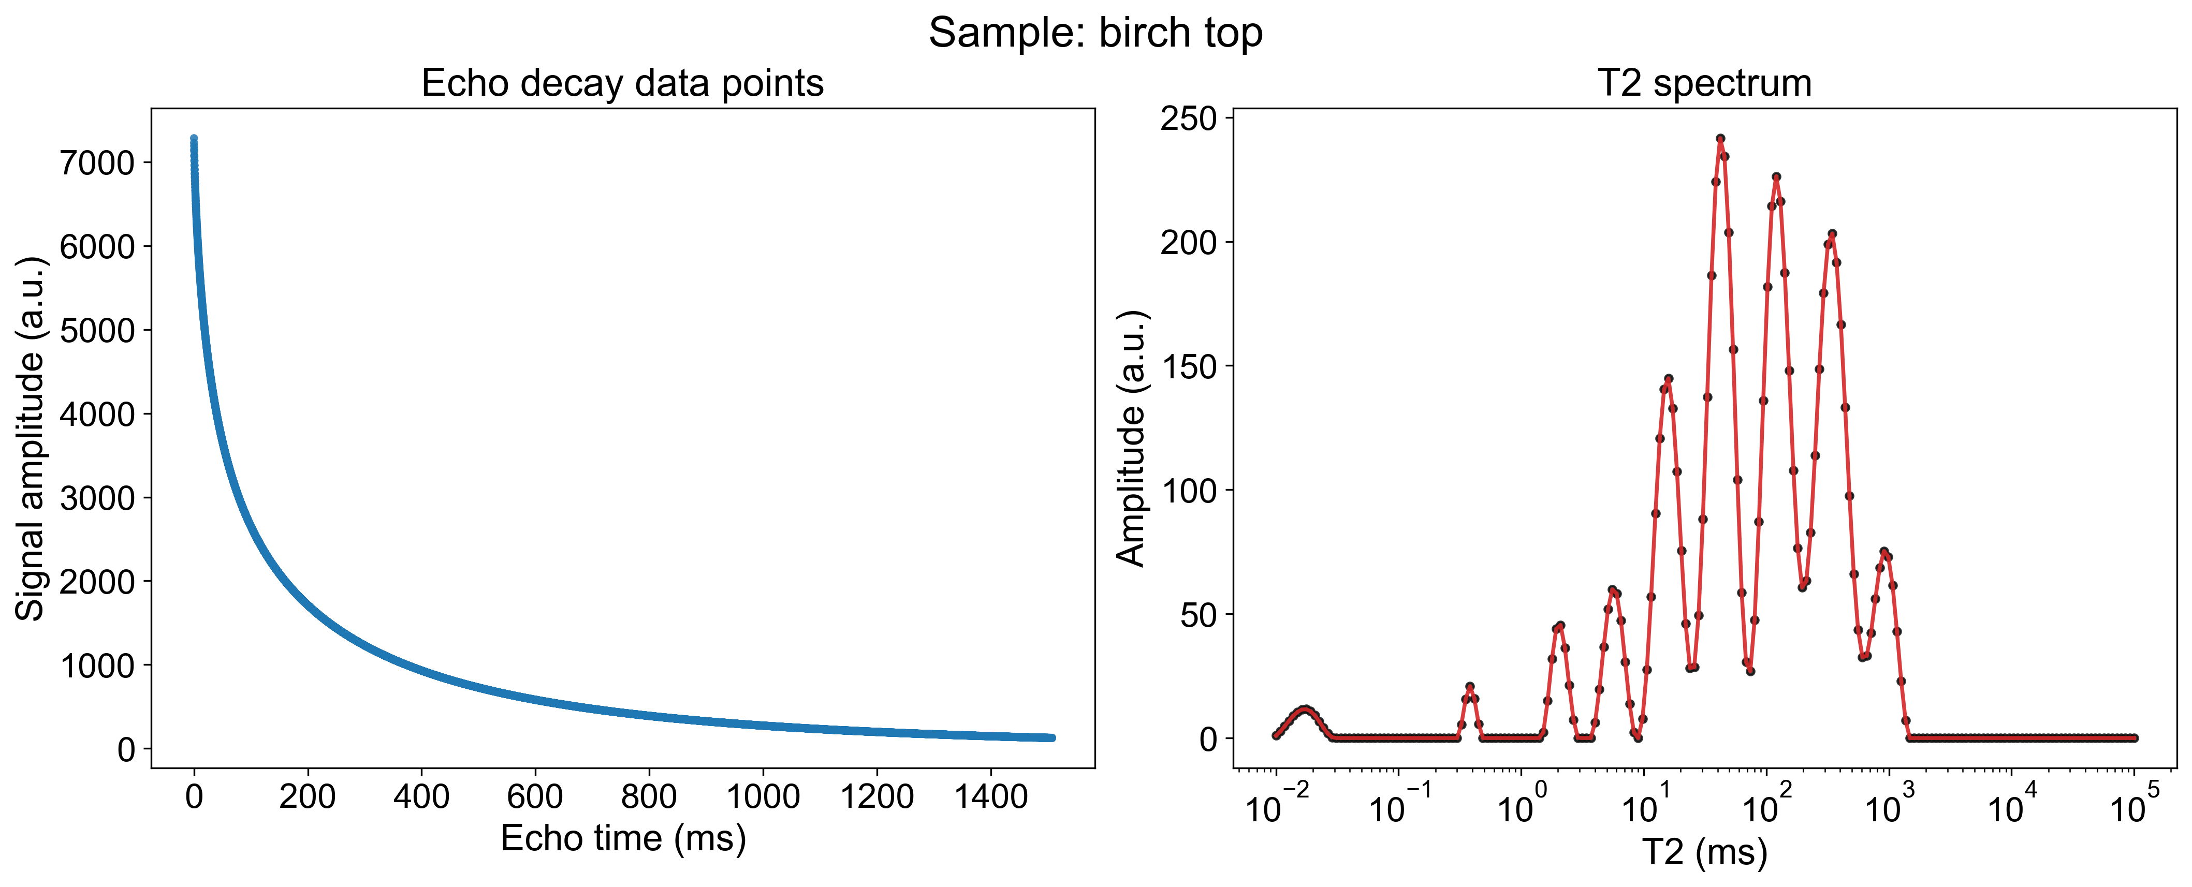

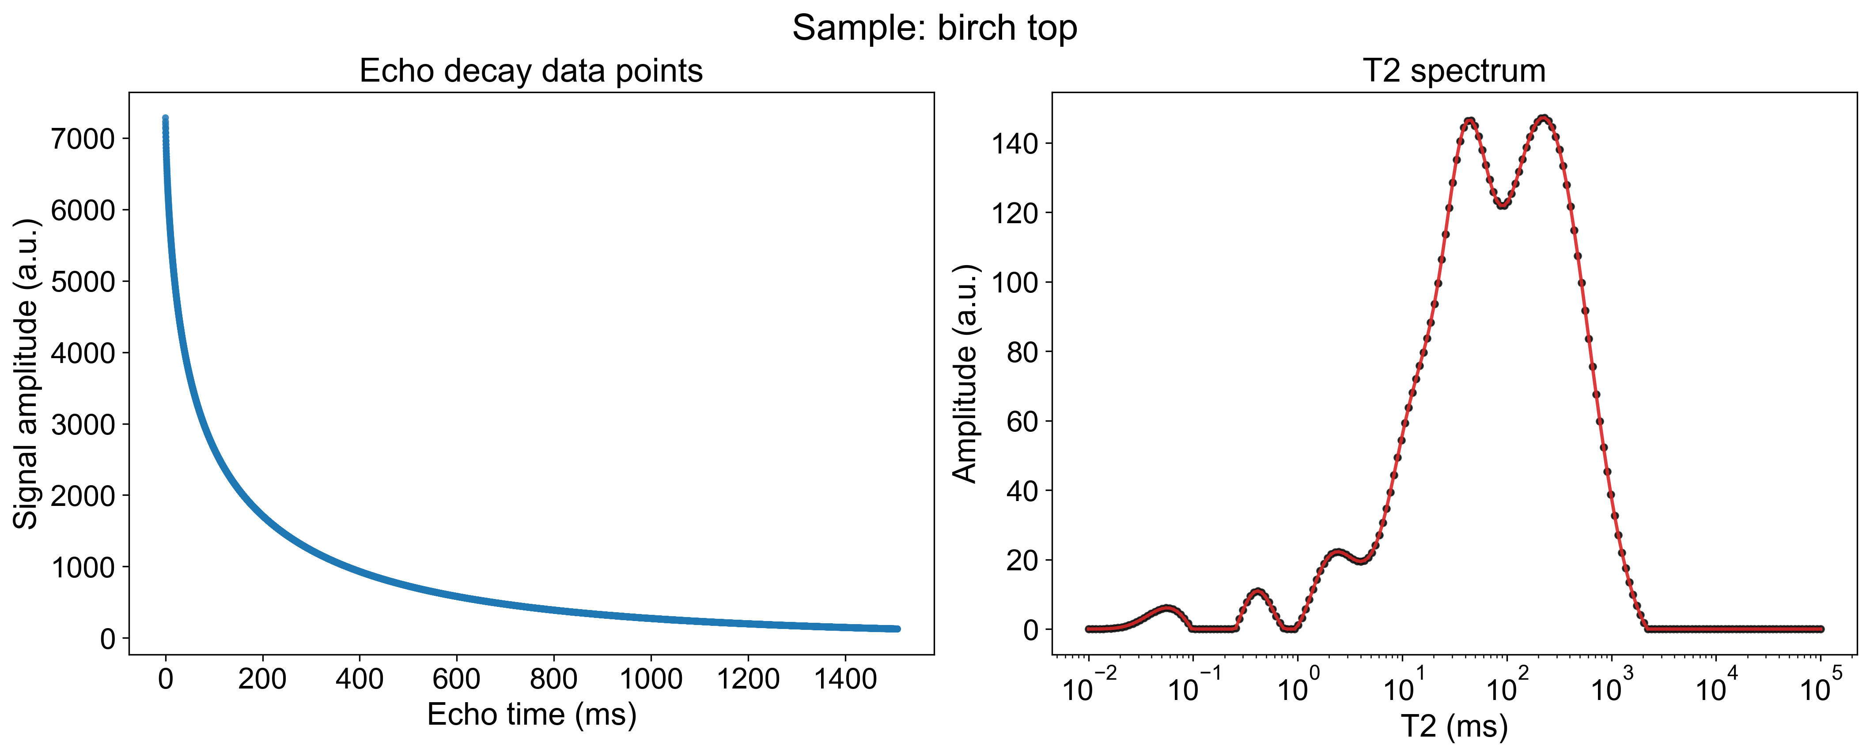
Nidhal's experimental data was inverted using the NNLS algorithm via the Bin’s code
REG_PARAM = 0.01
REG_PARAM = 0.001
REG_PARAM = 0.0003
Nidhal's experimental data was inverted using the NNLS algorithm via the Chi’s code
REG_PARAM = 1
REG_PARAM = 0.1
REG_PARAM = 0.01
Nidhal's experimental data was inverted using the BRD algorithm via the Junwen’s code
REG_PARAM = 1
REG_PARAM = 0.1
REG_PARAM = 0.01

Slide 11
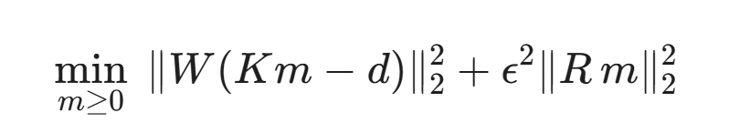
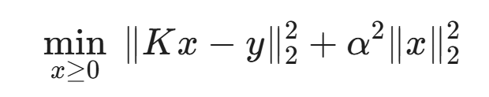
Why Bin’s NNLS code’s results do not match with Chi’s NNLS code’s?
Regularization Matrix Differences
Chi’s NNLS code
More rigorous
Bin’s NNLS code
2. Data Preprocessing Discrepancies: Chi’s NNLS code performs decay tail cropping, moving average filtering, and logarithmic resampling. Bin’s NNLS code applies raw measurement points without preprocessing, leading to fundamental inconsistencies in the input data matrices.
3. Baseline and Weighting Mechanisms: Chi’s NNLS code includes a baseline compensation column and noise standard deviation weighting. Bin’s NNLS code lacks these features, making it susceptible to absorbing systematic bias or heteroscedastic noise into the inversion spectrum, thereby distorting peak positions and widths.

Slide 12
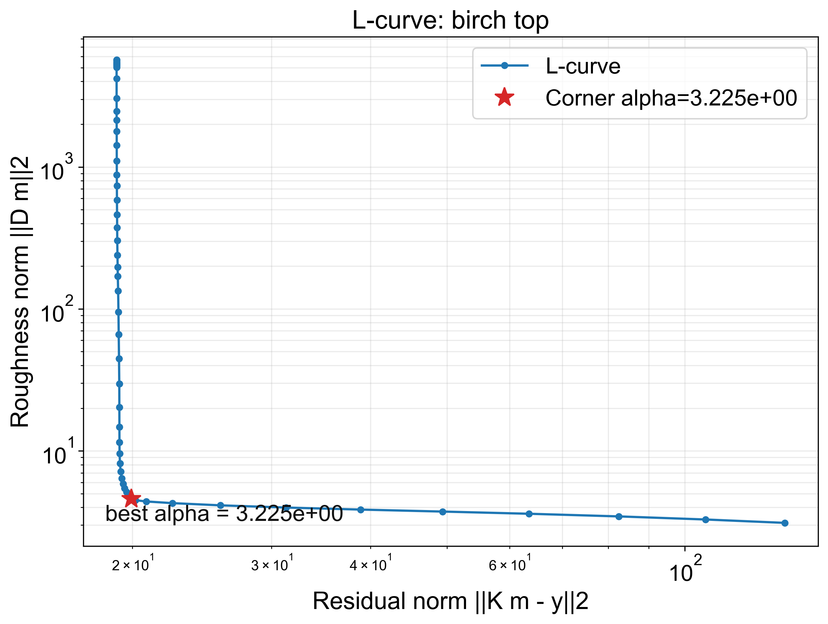

How to find best alpha parameter by NNLS code?
1. Core Objective: Dual-Index Balancing
Seek the optimal alpha to achieve the best trade-off between fitting error (accuracy) and model roughness (smoothness).
2. Operational Logic: Batch Iteration
Substitute a sequence of increasing alpha values to simultaneously calculate the error term and roughness term for each parameter set.
3. Optimization Mechanism: L-Curve Corner
Plot the error against roughness to identify the maximum curvature point (corner) of the L-shaped curve, locking in the balanced solution.

Slide 13
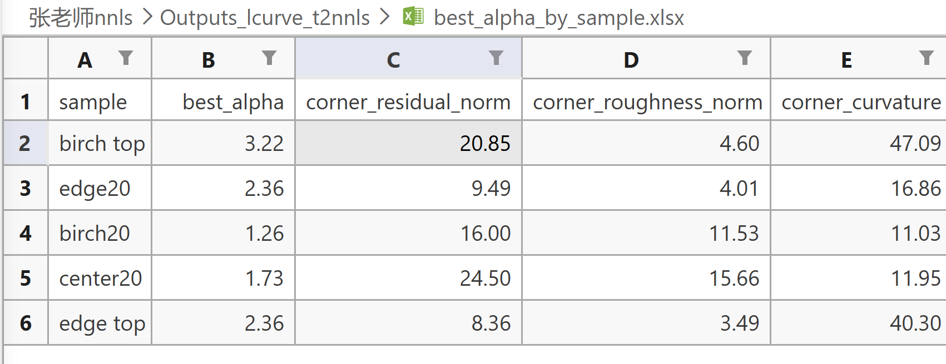
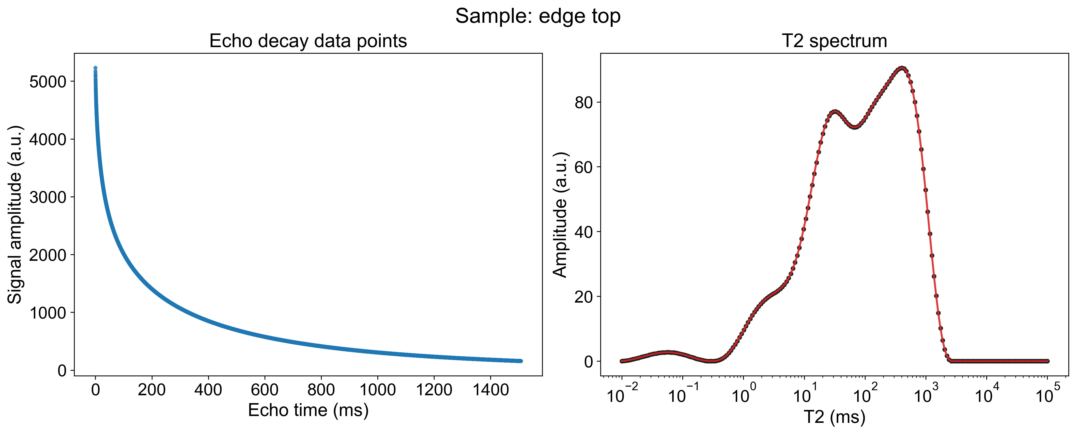
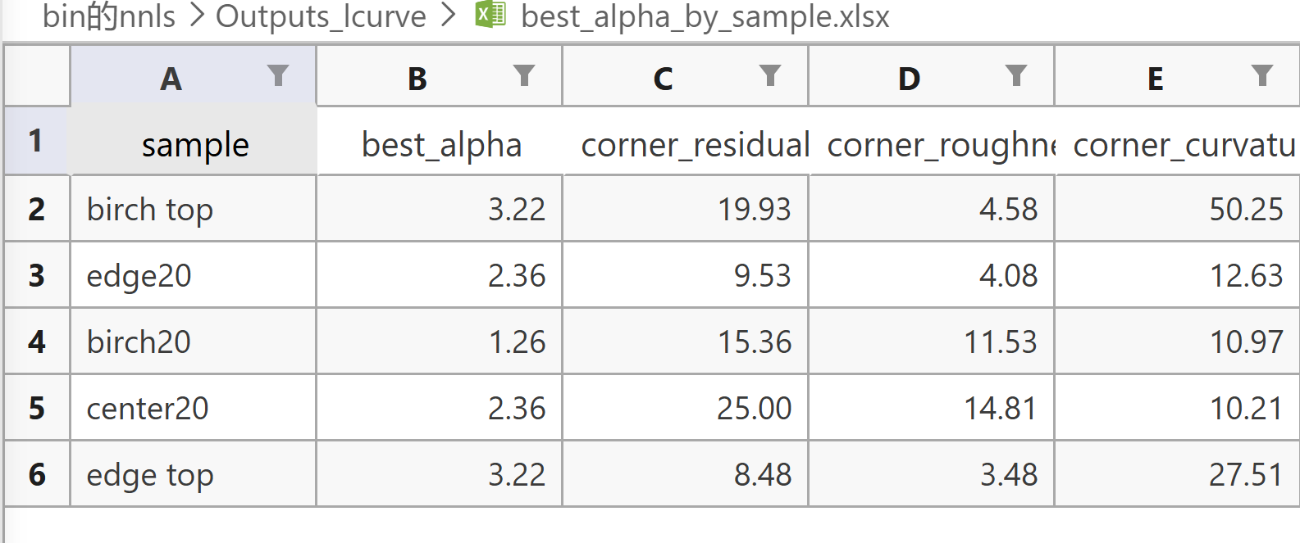

Transcribe Chi's NNLS algorithm into Python.
Chi's NNLS MATLAB code
Chi's NNLS Transcribed Python code

Slide 14
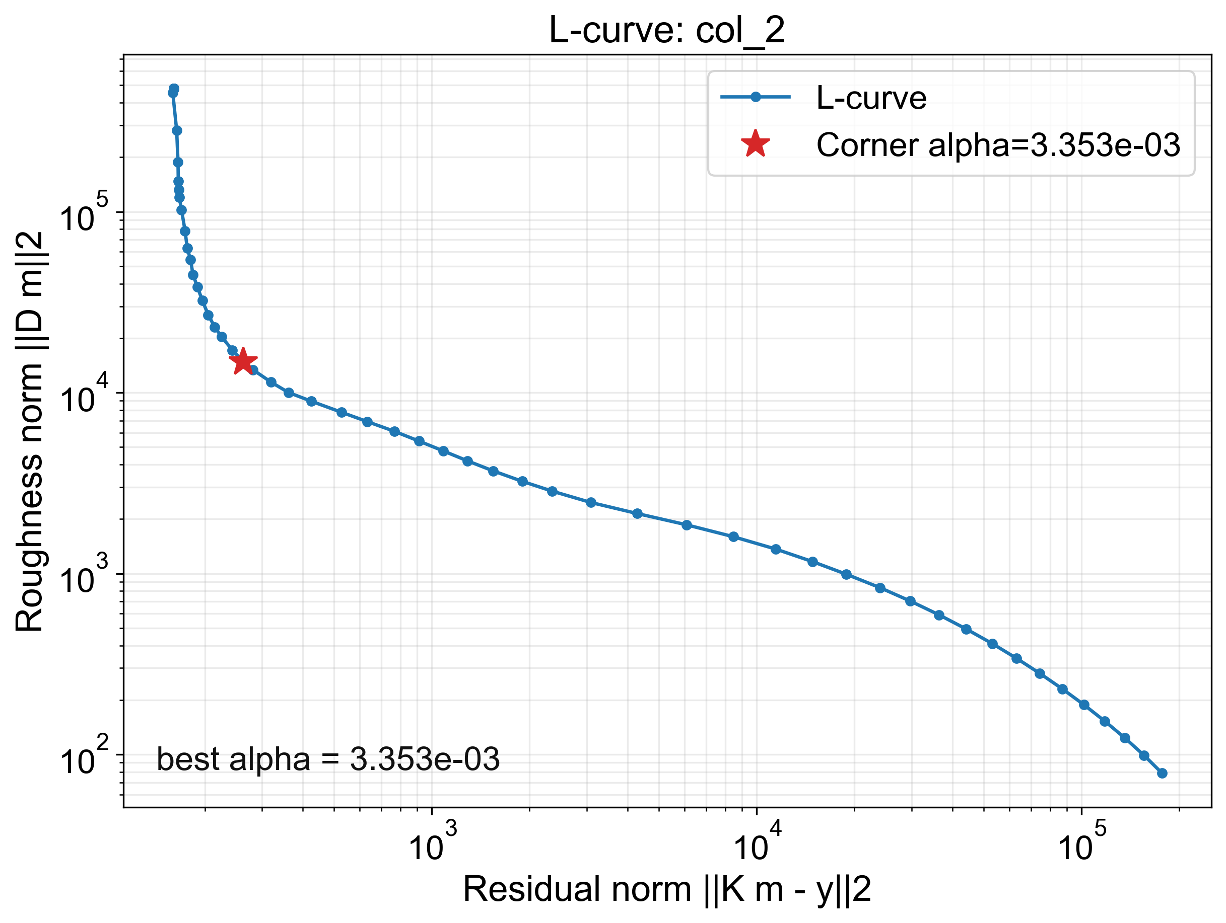
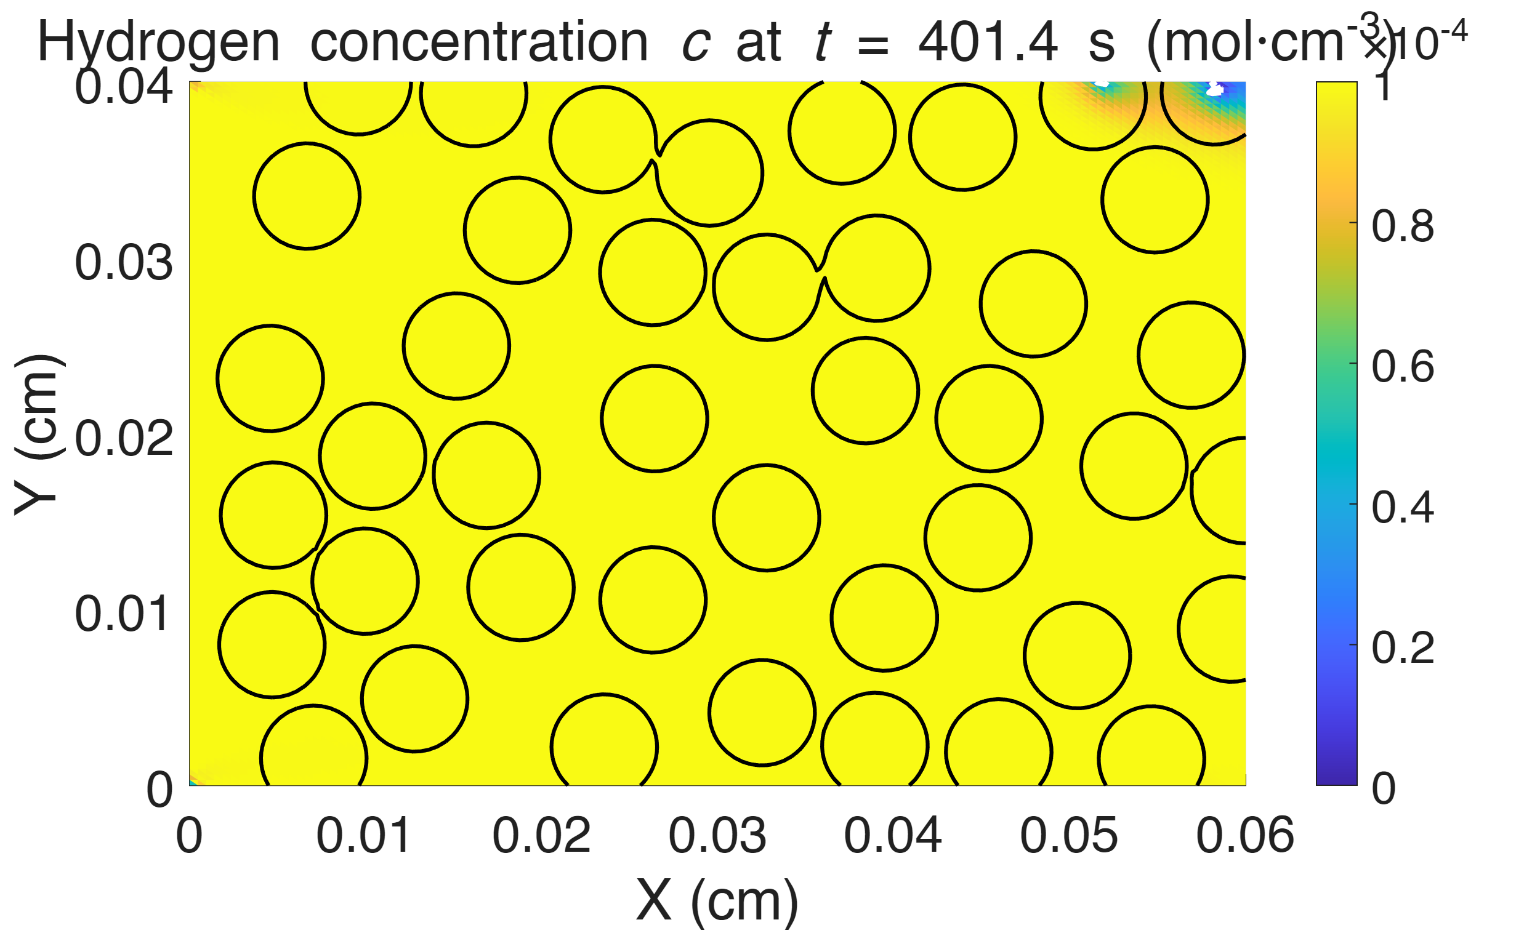
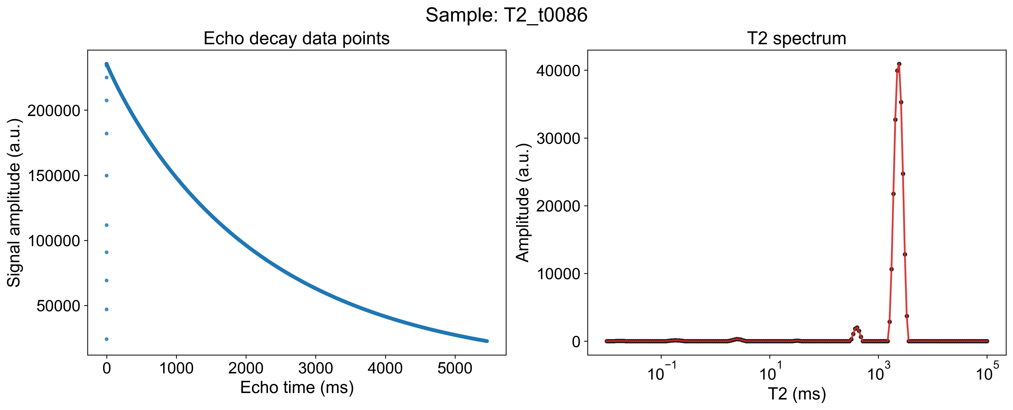
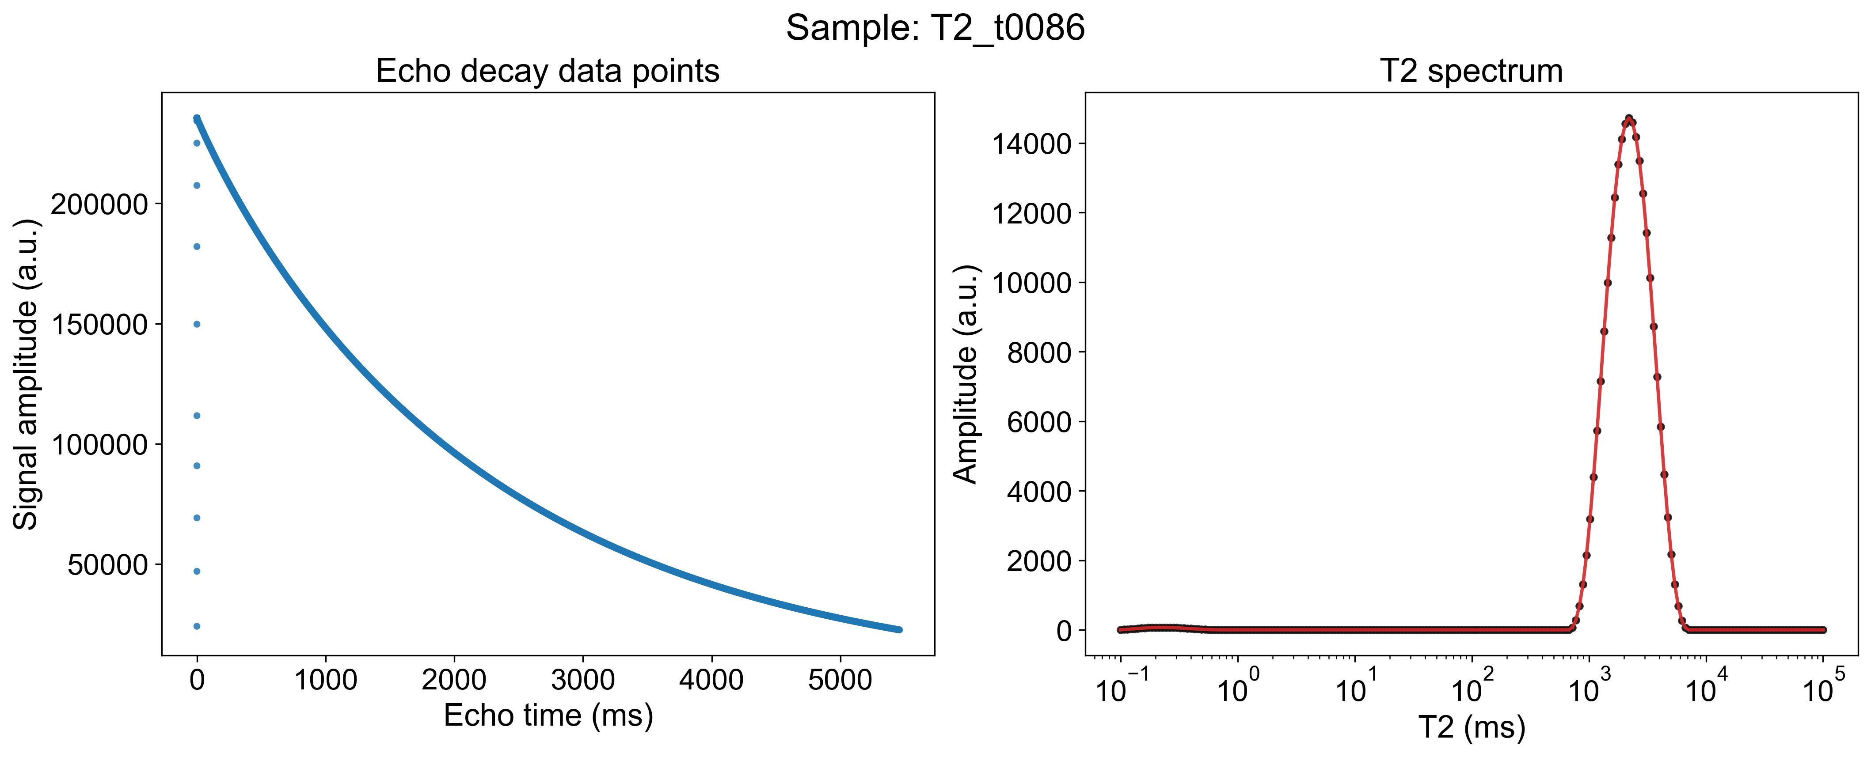
Note: A fixed smoothing factor works better for simulated data.

Slide 15
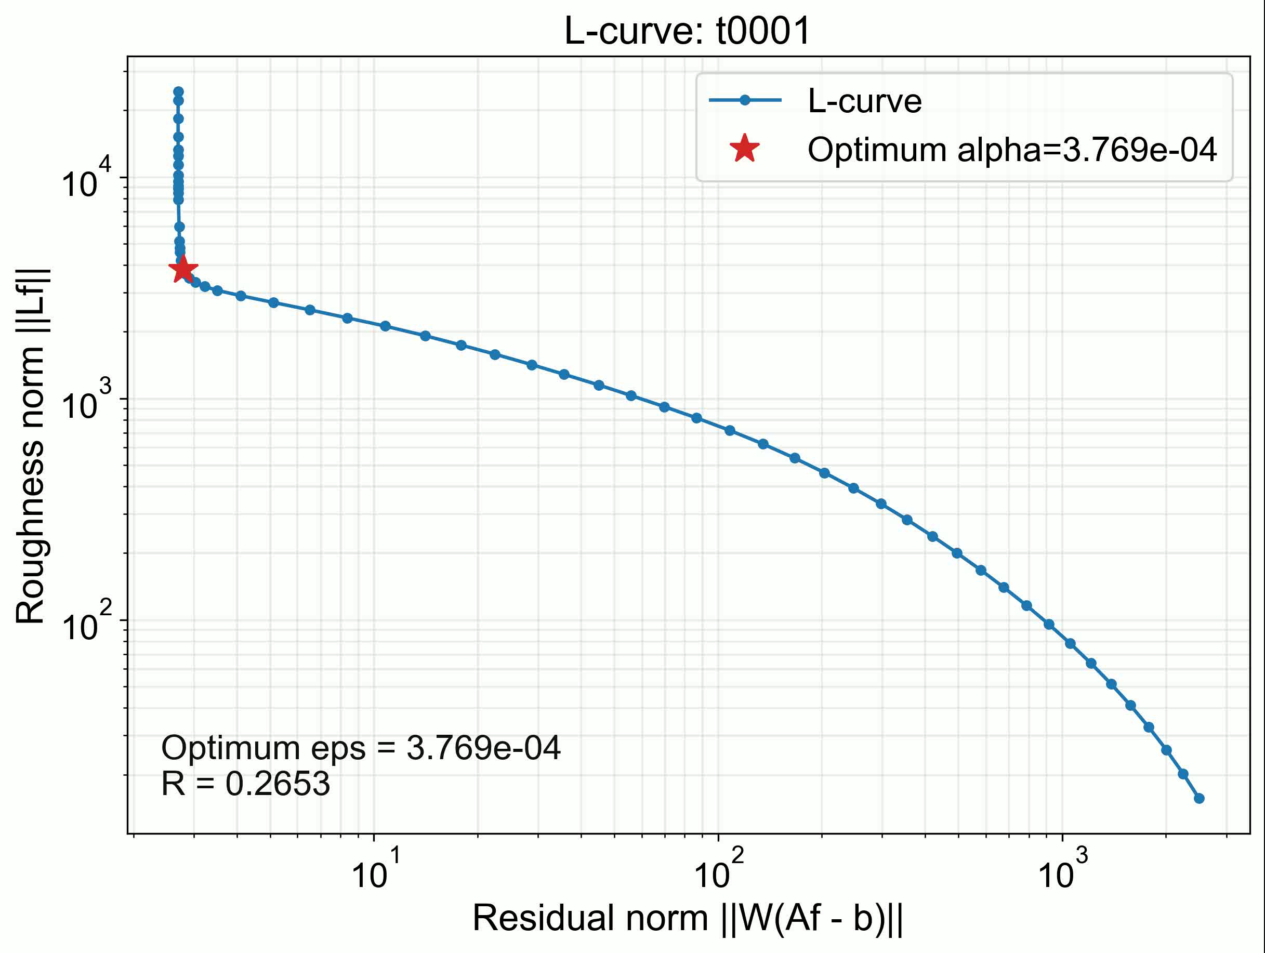
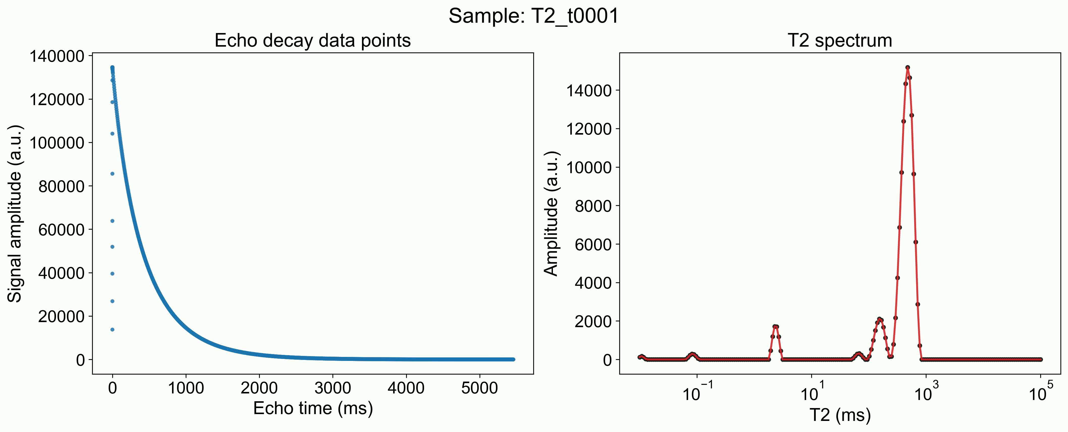
Pe=0.1

